Slide 1

THz SIS devices and waveguides
AETHER Sub-Task 4.2 & 4.3
KOSMA: University of Cologne
Karl Jacobs, Netty Honingh

Slide 2
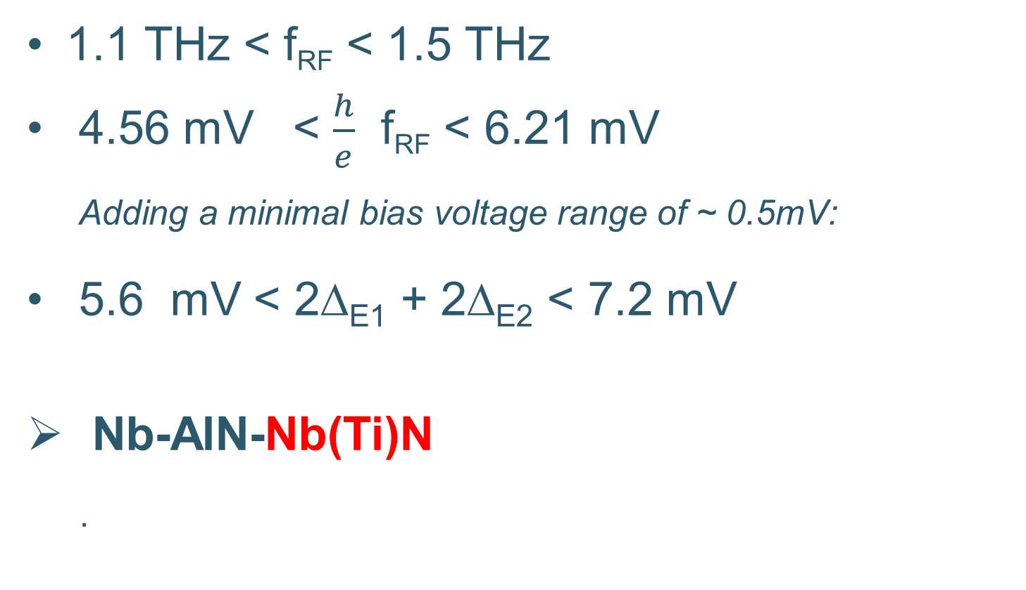
THz SIS devices_ junctions
1.1 THz < f_{RF} < 1.5 THz
4.56 mV < $\frac{h}{e}$ f_{RF} < 6.21 mV
Adding a minimal bias voltage range of ~ 0.5mV:
5.6 mV < 2Δ_{E1} + 2Δ_{E2} < 7.2 mV
Nb-AlN-Nb(Ti)N
  .

Slide 3
Simulated Pumped IV‘s

Slide 4
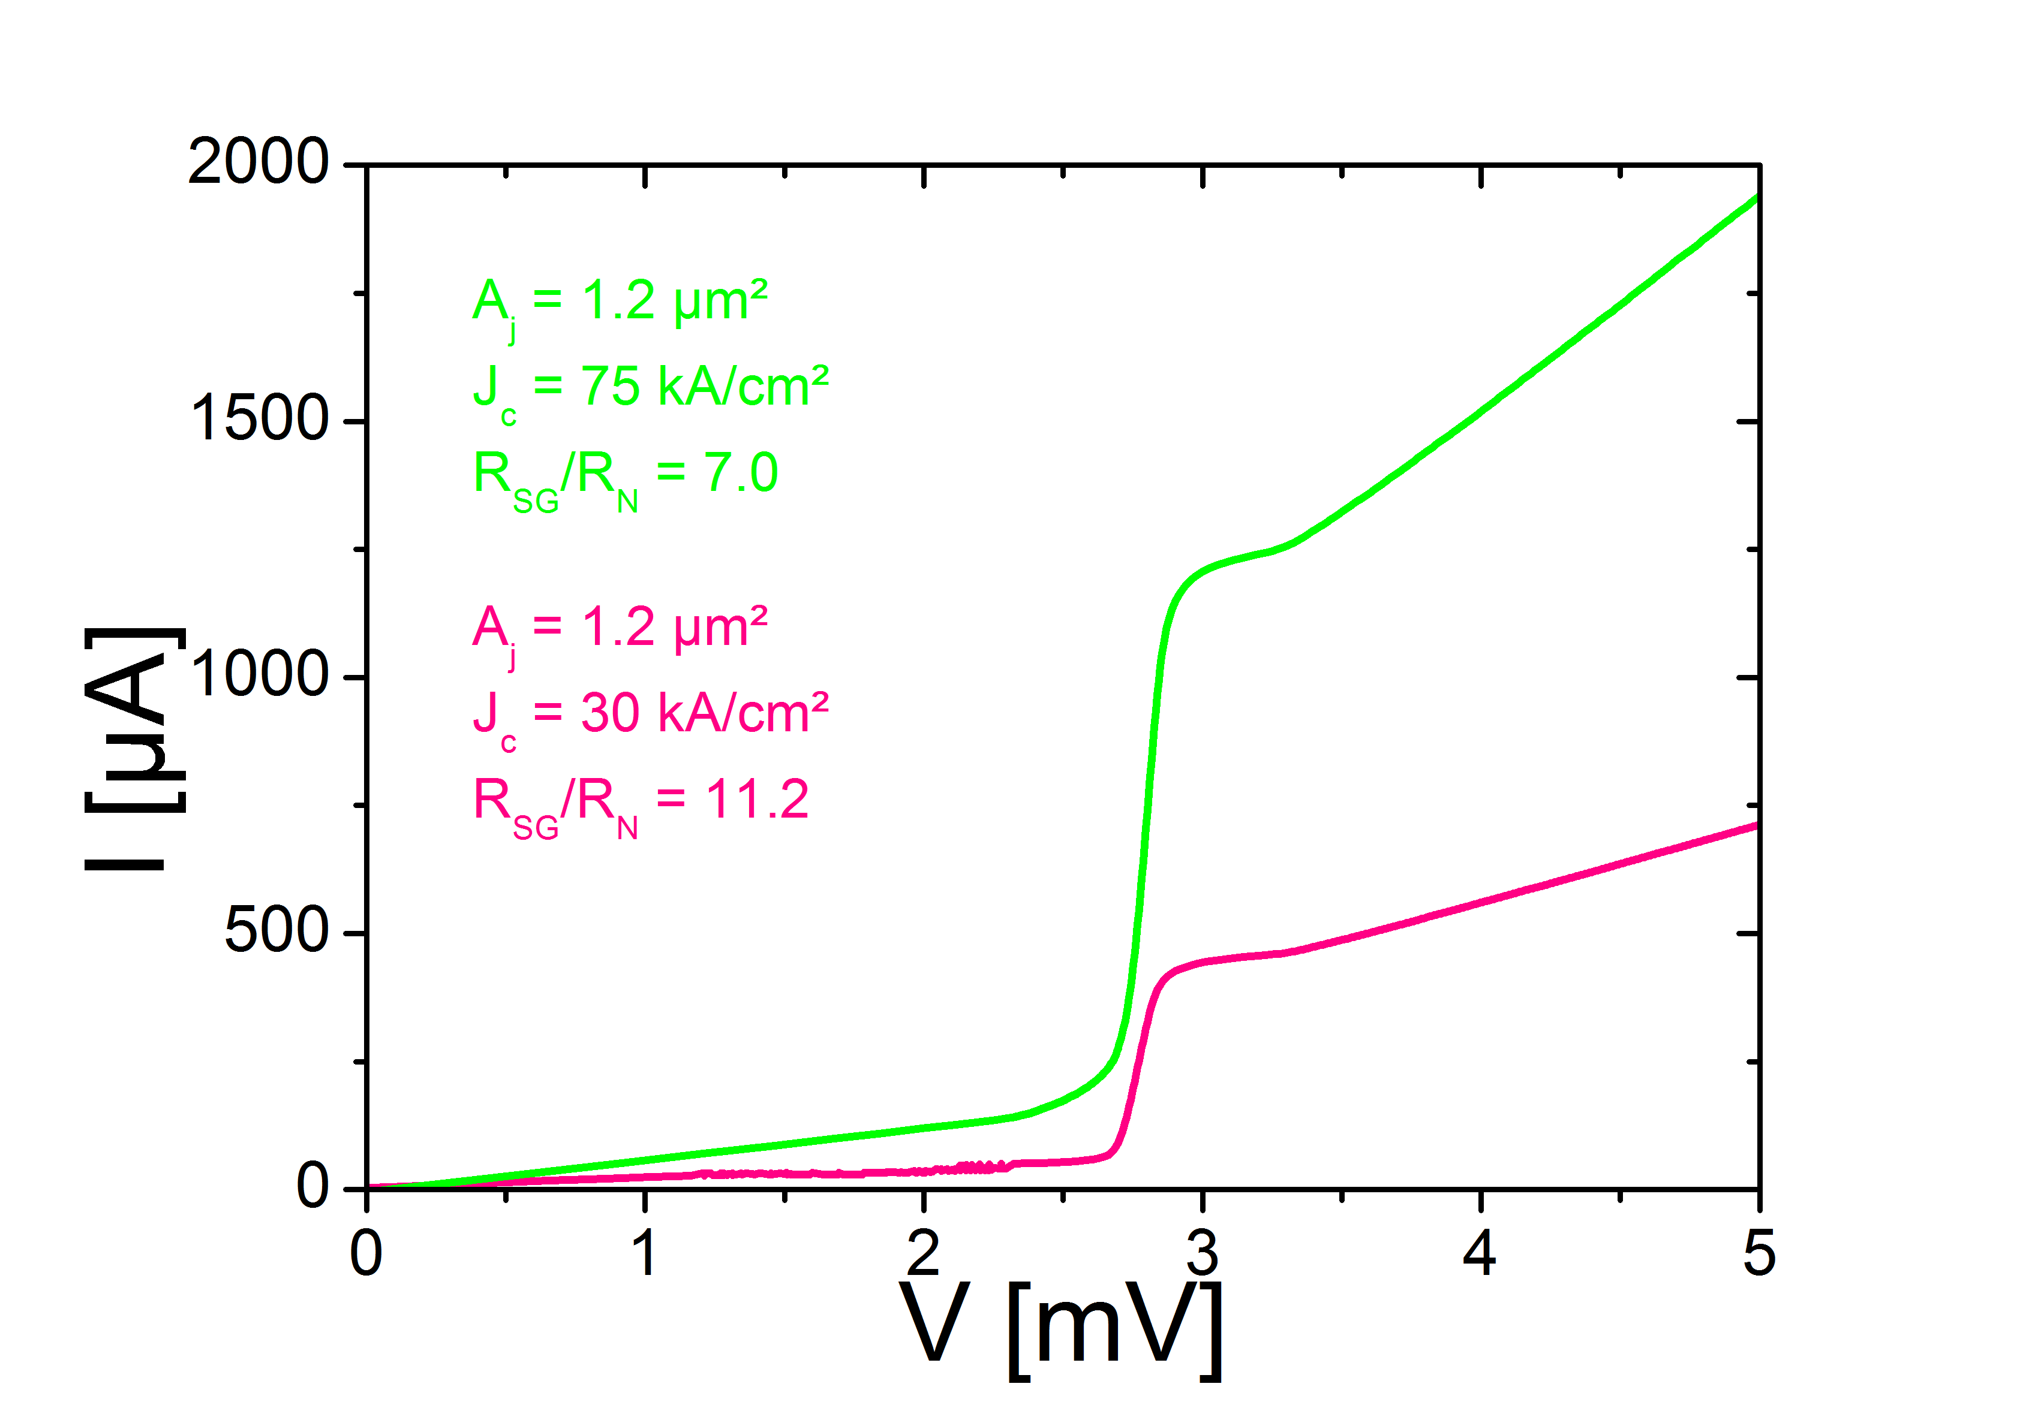
Nb-AlN-Nb
Reproducible
Quality > 10 , for Jc~30kA/cm²

Slide 5
THz SIS devices
No progress on junction top electrode other than Niobium (resources)
E-beam lithography required for tuning
  Can be based on heritage of HEB fabrication
  Details will be determined when SIS junction with sufficient V_{gap} are there.

Slide 6
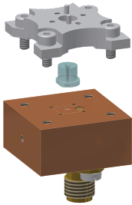
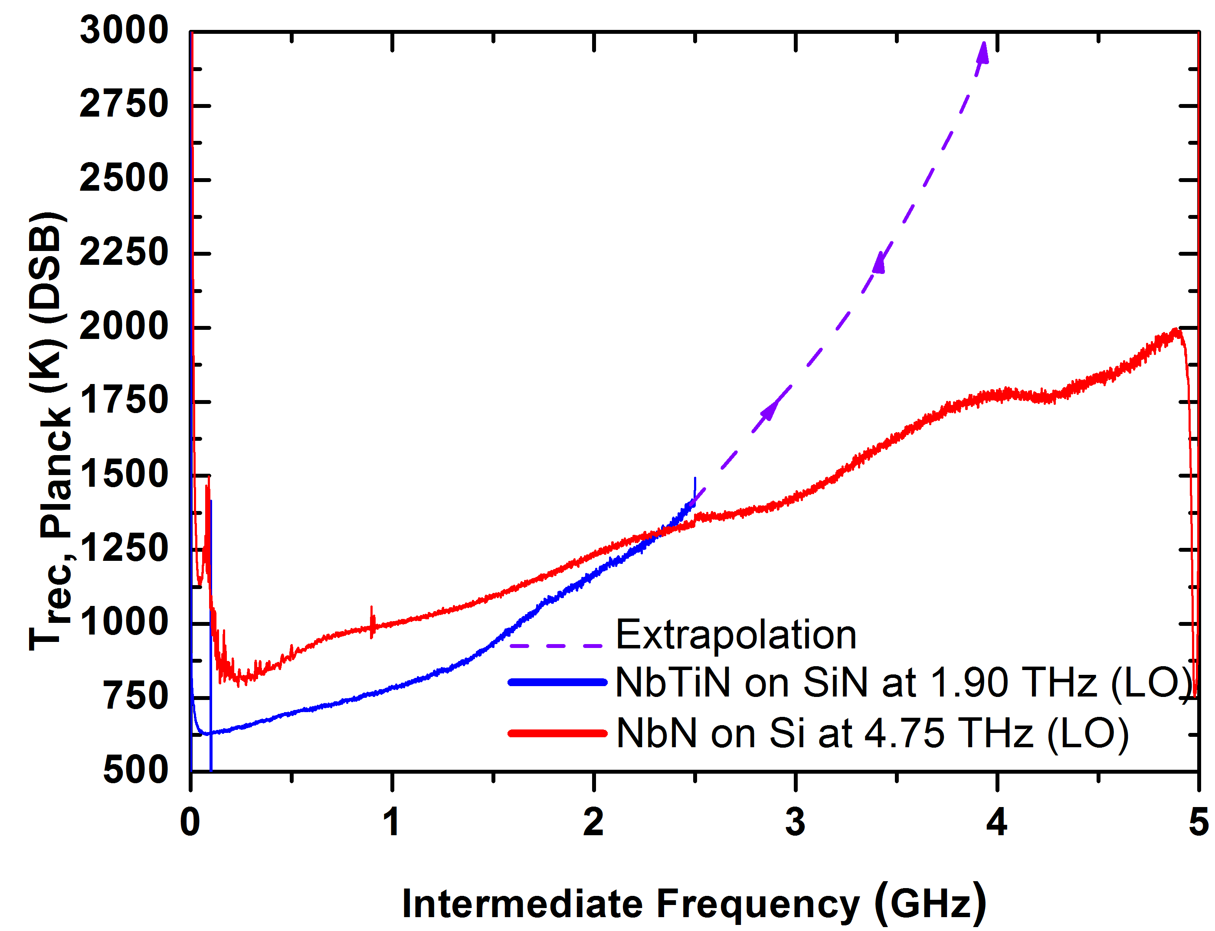
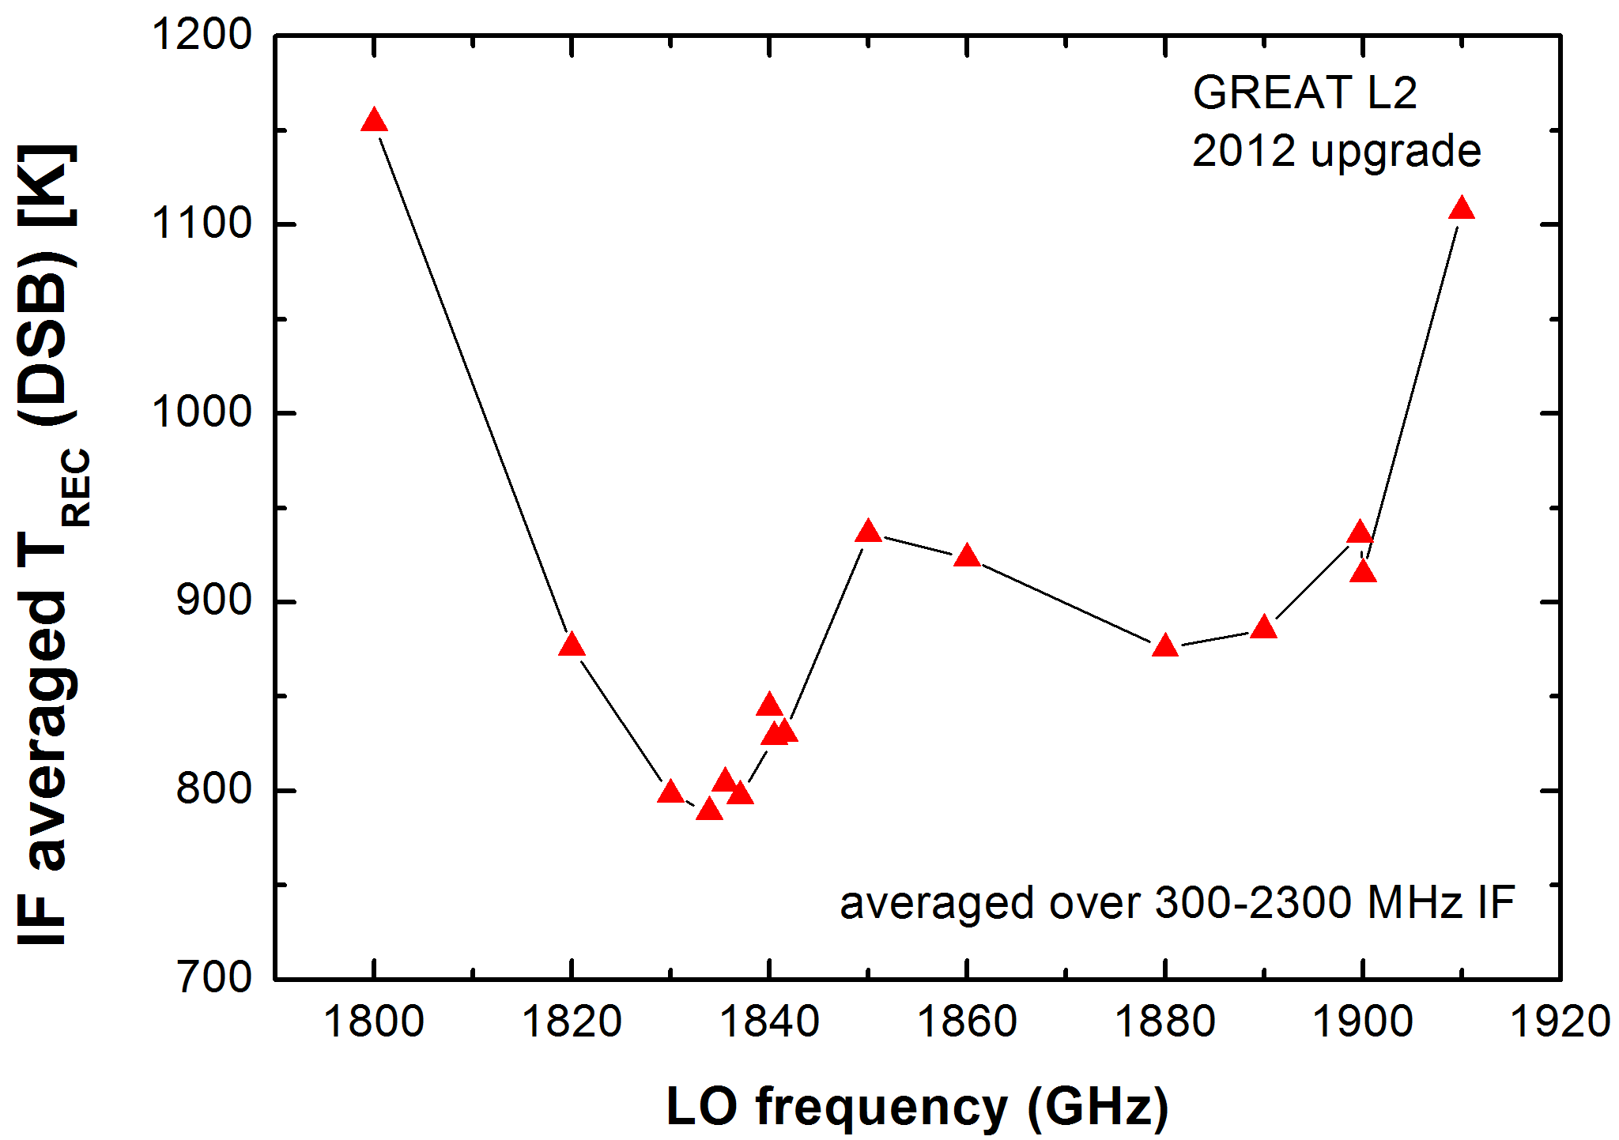
THz Waveguides
Stamped waveguides in CuTe up to 5 THz
RF Signal
This years PR meeting
Last years PR meeting
3. clamp
1. feedhorn
3. device
10 mm
17 mm
2. waveguide block with IF output
IF Signal

Slide 7
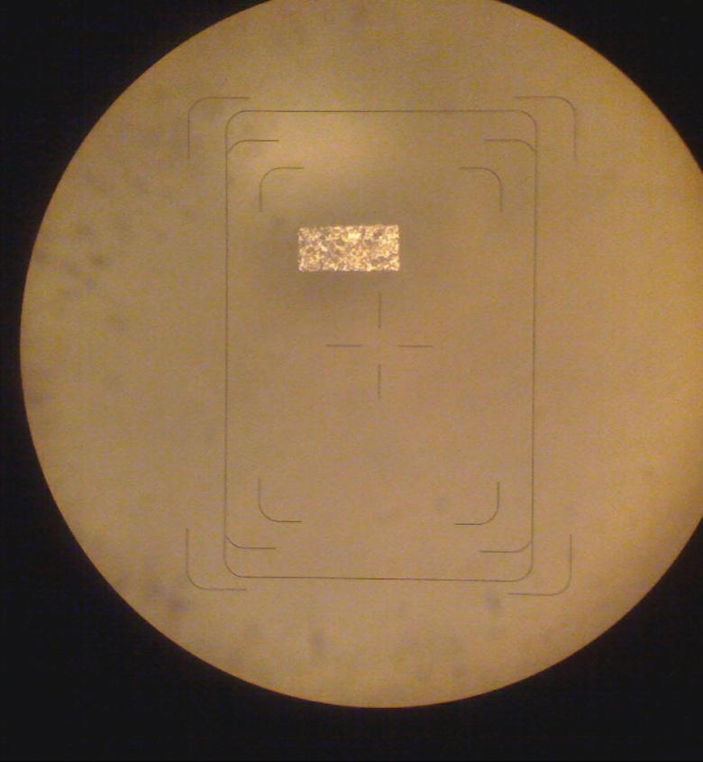
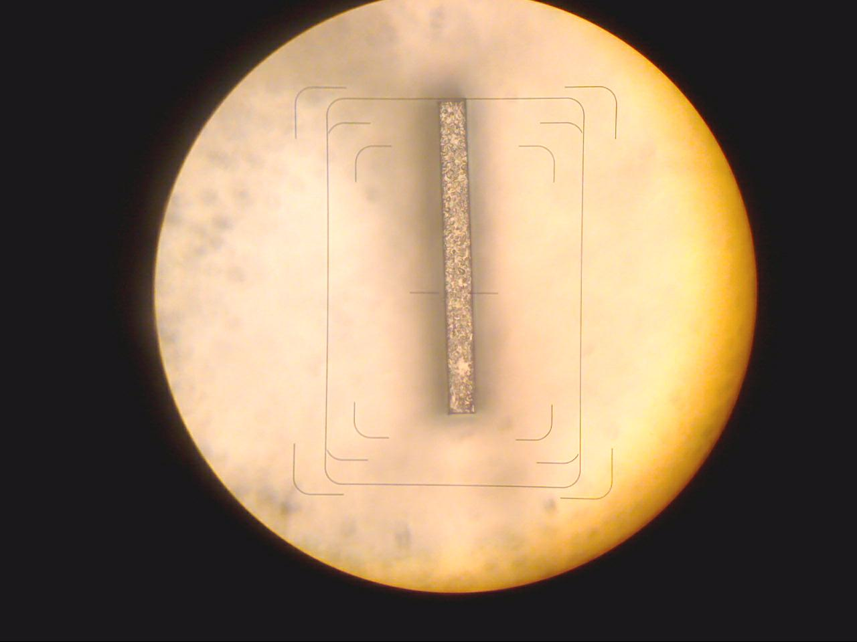
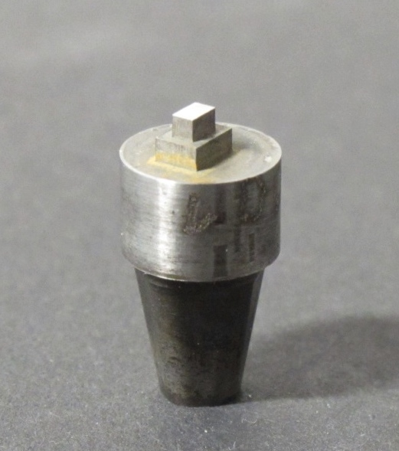
In house Tooling
Channel stamp
Stamping tool
Waveguide stamp
48 µm
1 cm
16µm
4.7 THz waveguide 48 µm x 24 µm

Slide 8
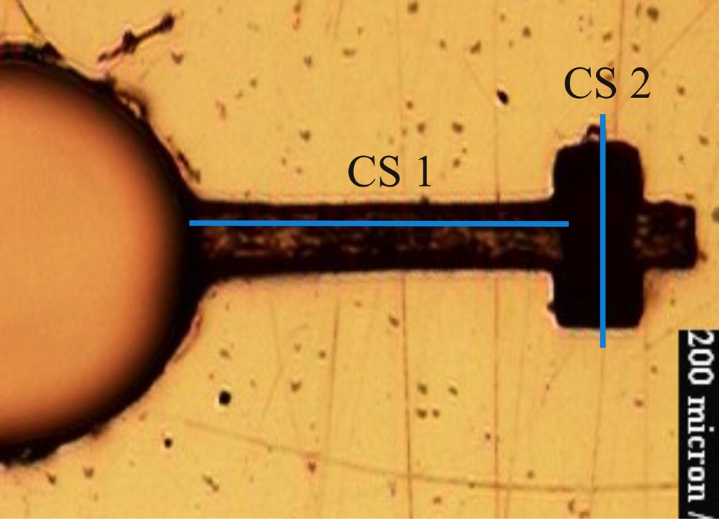
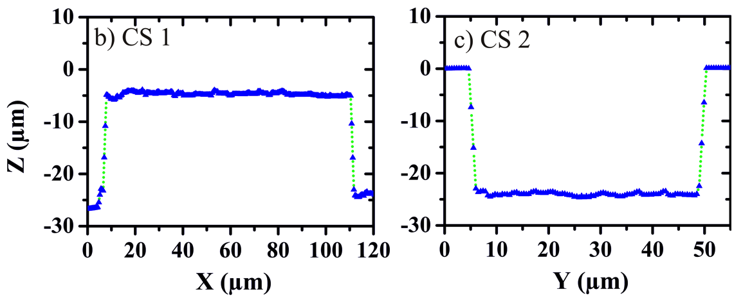
Waveguide wall roughness
roughness Ra < 0.2 µm, RMS = 0.3
required accuracy | width (µm) |  | length (µm) |  | depth (µm)
Waveguide | 24 | +/- 2 | 48 | +/- 3 | 22 | +/- 2
Substrate Channel | 14 | +2/ -0 | 105 | +0/ -5 | 4 | +2/- 0
4.7 THz
8

Slide 9
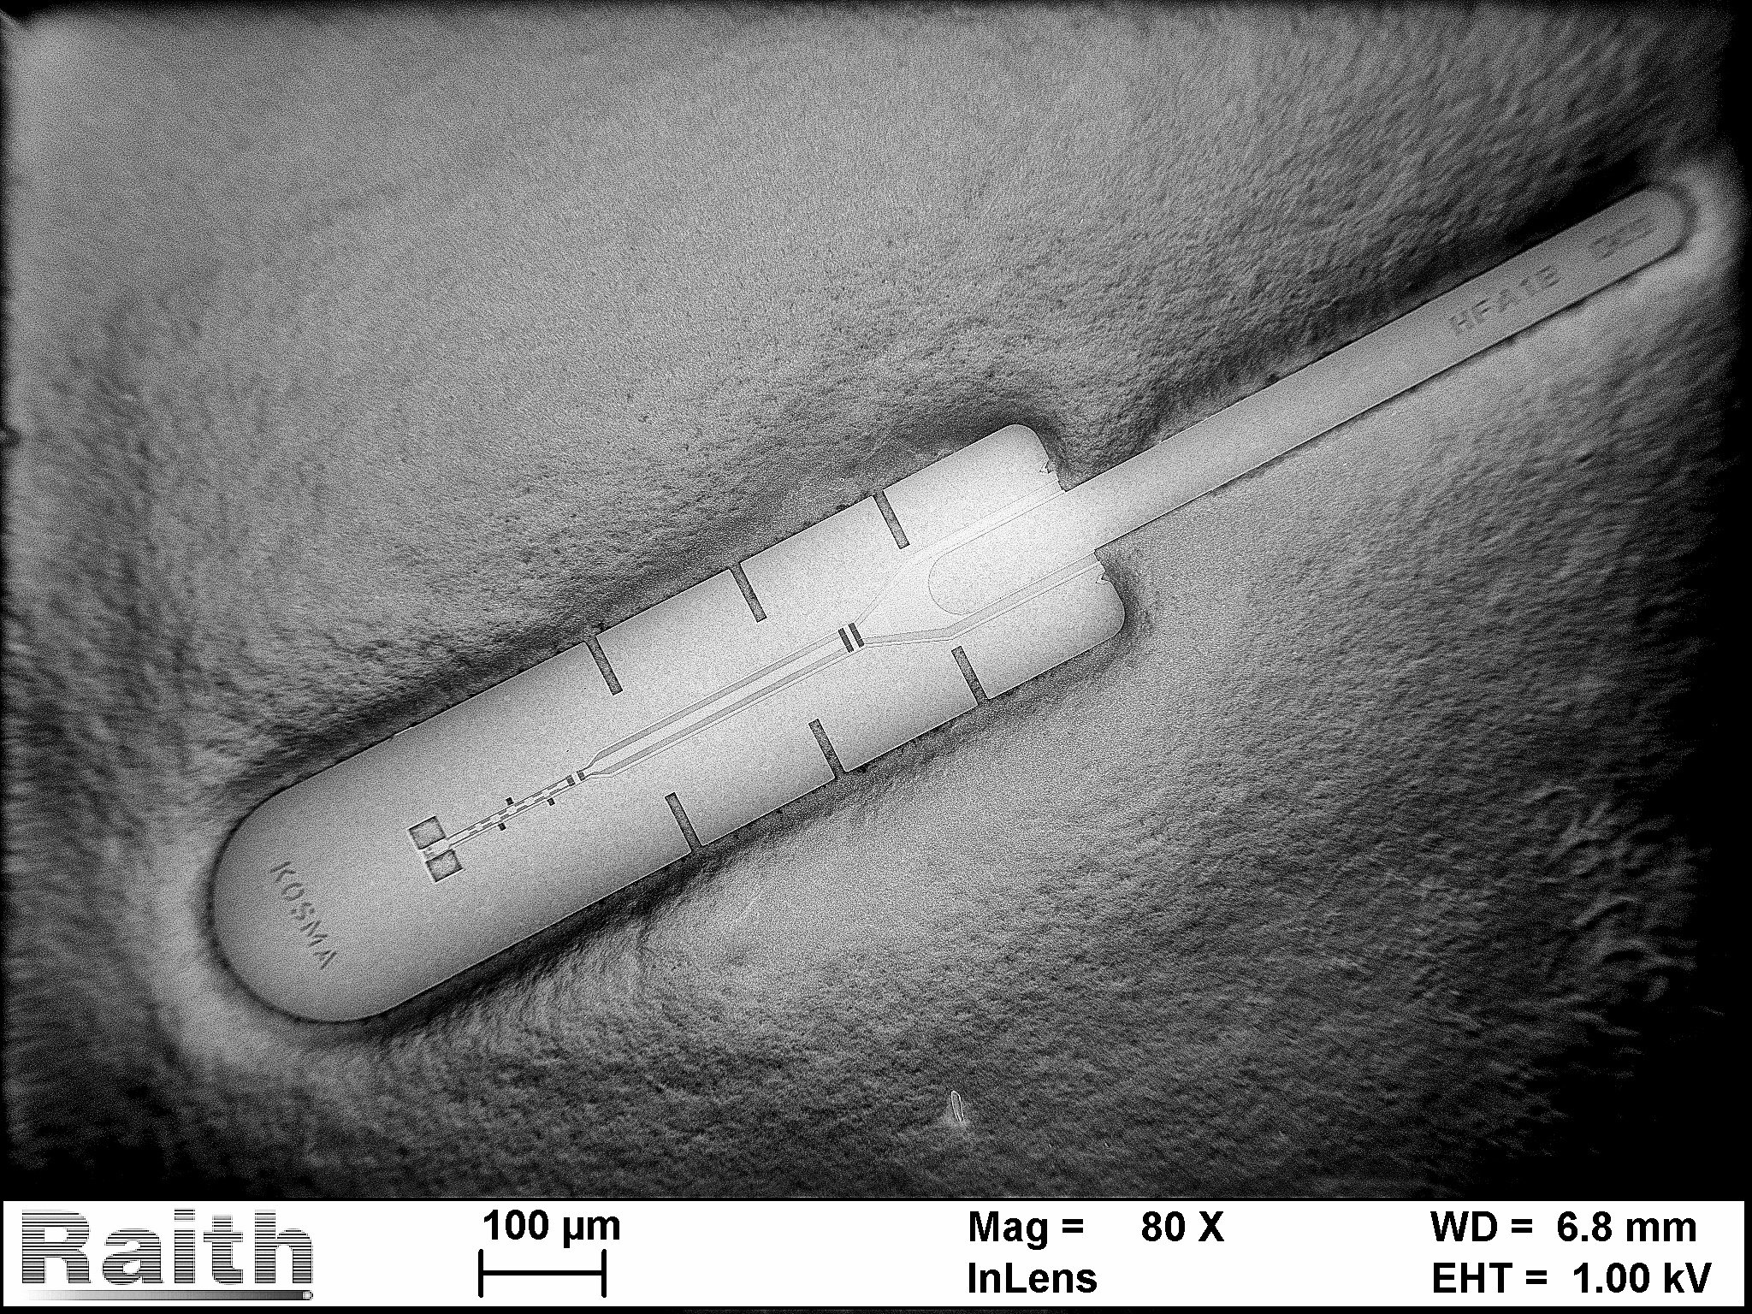
4.7 THz HEB Devices
4.7 THz waveguide HEB device
IF output and DC connection
RF input section
1250 µm
9

Slide 10
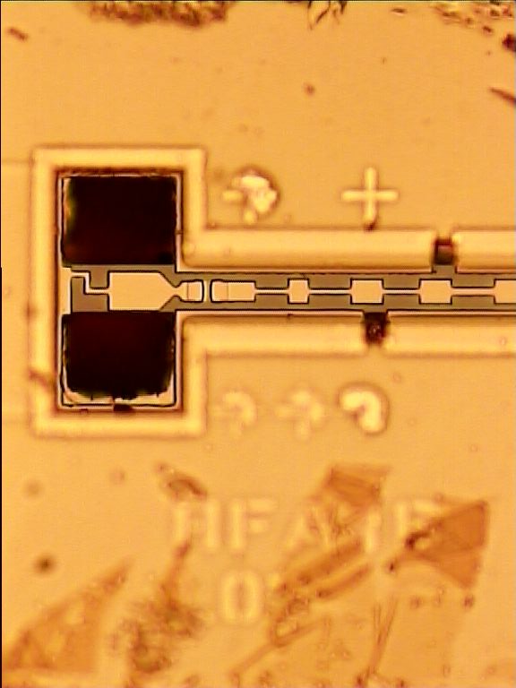
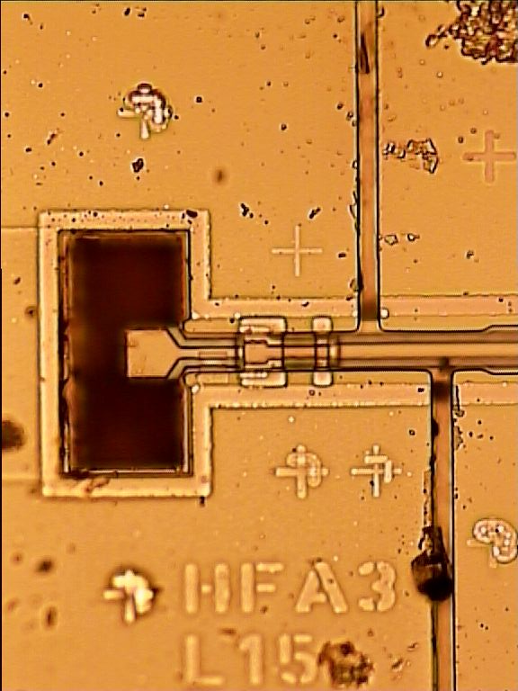
Device Assembly
Device aligned to waveguide by windows in beamlead
All electrical contacts via beamleads

Slide 11
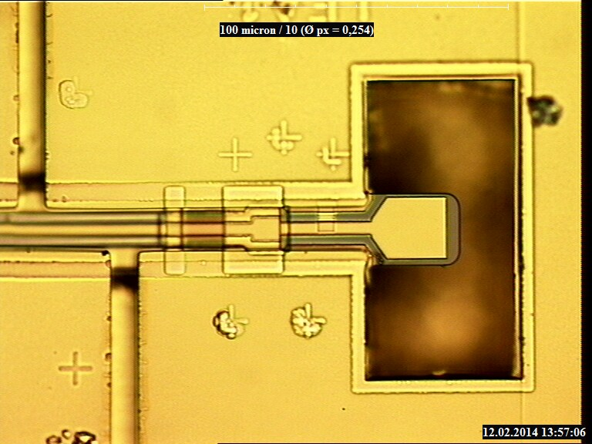
Device aligned to waveguide
24 µm
HEB microbridge
waveguide
window
48 µm
LFA device
11

Slide 12
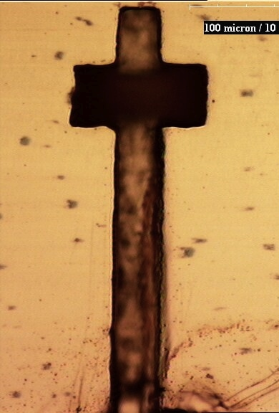
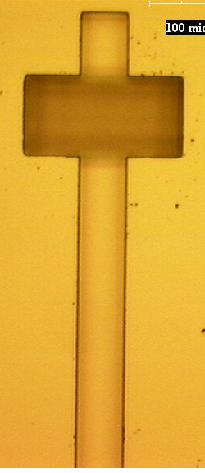
Waveguides etched in Si
Less roughness
cheaper series- production
Tests under way at 1.9 THz
Platzhalter SEM Bild
50 µm
50 µm

Slide 13
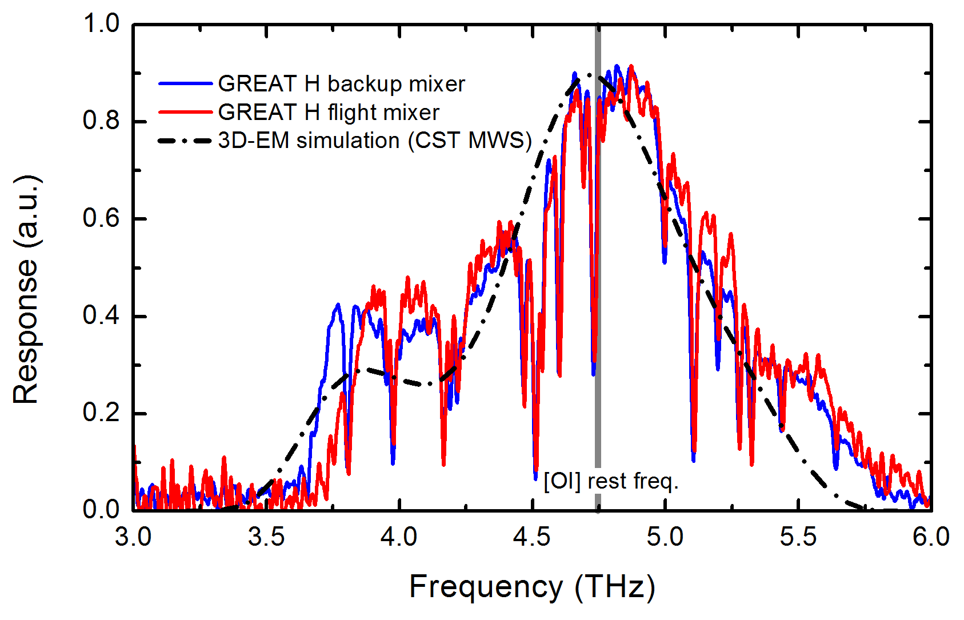
Measurement & design
Simulation in CST_microwave Studio
Materials properties at THz frequencies modelled analitically, based on measured DC cryo-properties

Slide 14
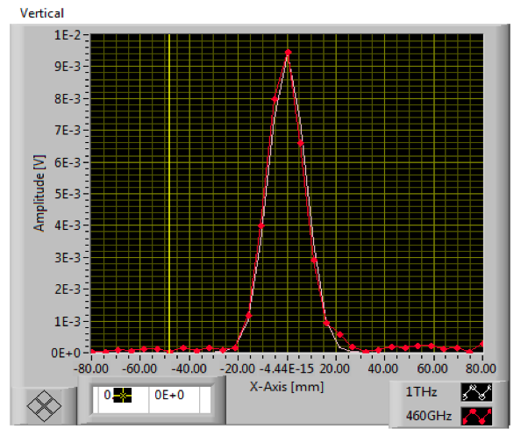
Beam verification
Horns fabricated by RPG
optics path not evacuated ca. 35 cm @ 4775 GHz
waist size and beam shape good to – 12 dB testing limit
flight mixer
backup mixer
contours 1.5 dB
red = -3 dB
green = -12 dB
courtesy
C. Risacher, MPIfR

Slide 15
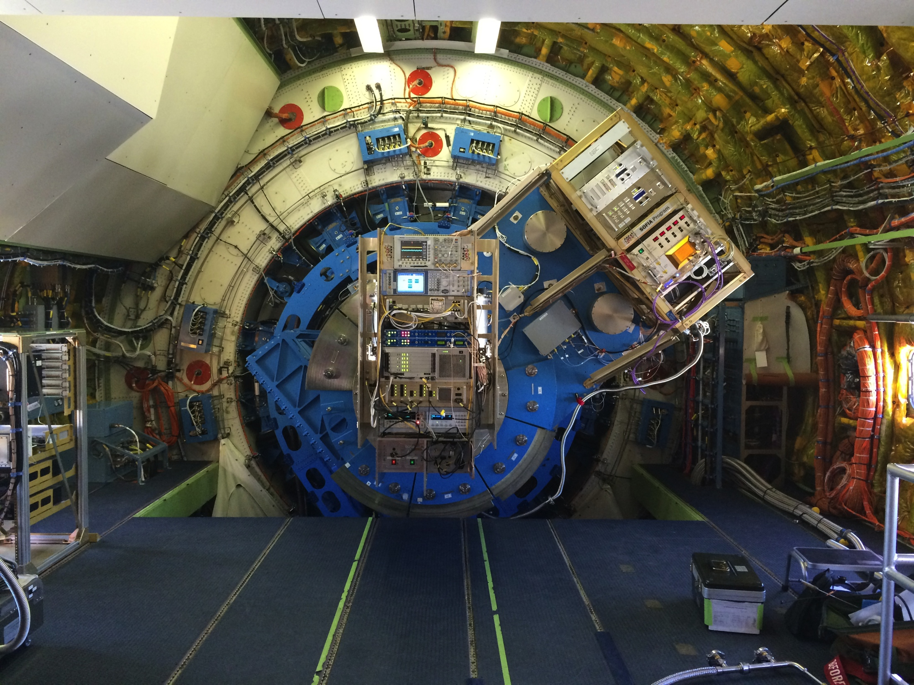
GREAT with 1.9 and 4.7 THz Rx on SOFIA

Slide 16
In-Flight Trec GREAT H-Channel
Trec SSB (K)

Slide 17
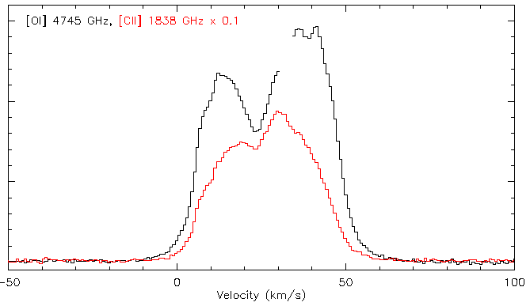
[O I] and [C II] line emission
courtesy Helmut Wiesemeyer
GREAT consortium

Slide 18
Summary
SIS devices
  AlN barrier: stable process
  New KOSMA sputter machine very probable
  E-beam processing heritage of HEB development
THz waveguide blocks
  Metal waveguides OK up to 5 THz
  Si waveguides ready---tests delayed
Assembly
  Within required tolerance using beamleads
  Cryo thermal contact OK, cryo cycling OK

Slide 19
Horizon 2020—KOSMA proposal
ALMA second generation instrumentation
=> small FPA‘s with balanced side band separating mixers
Common European effort = our JRA
  Mixers , LO‘s , IF (LNA), …
Frequency range 460GHz - 1 THz(?)
Common prototype + tests + evaluation (result of JRA)
What can each participant contribute ?
  e.g. KOSMA Fabrication of devices, SOI+Beamleads
How can we make the cooperation work ?

