Slide 1
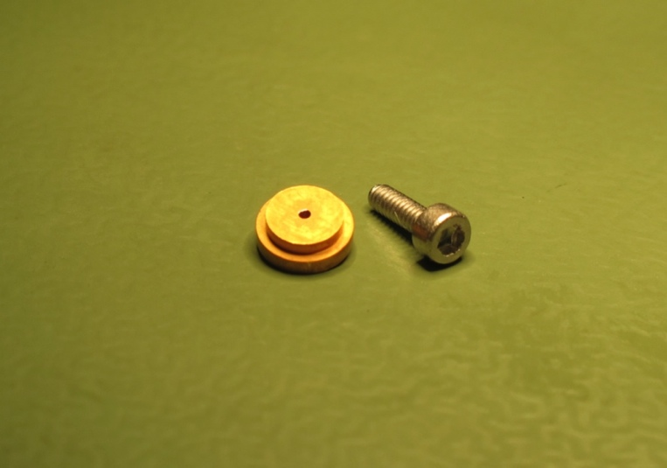
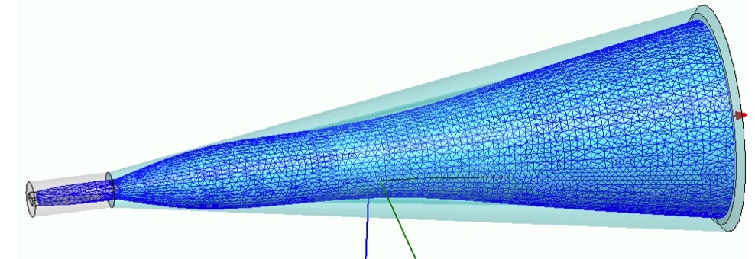
Feedhorn antennas for upGREAT
high performance feedhorns
smooth-walled spline profile (Granet 2004, Zeng 2010)
optimized beam characteristics in 3D-EM modeller and fabricated by electroforming (Radiometer Physics GmbH)
1.9 – 2.5 THz (wideband), 4.7 THz
specs FPBW(-10 dB)=19.5°, G=25 dBi
4.7 THz feedhorn
M1.6
0.7 mm aperture
circ. to rect.
WG transition
2.4 mm

Slide 2
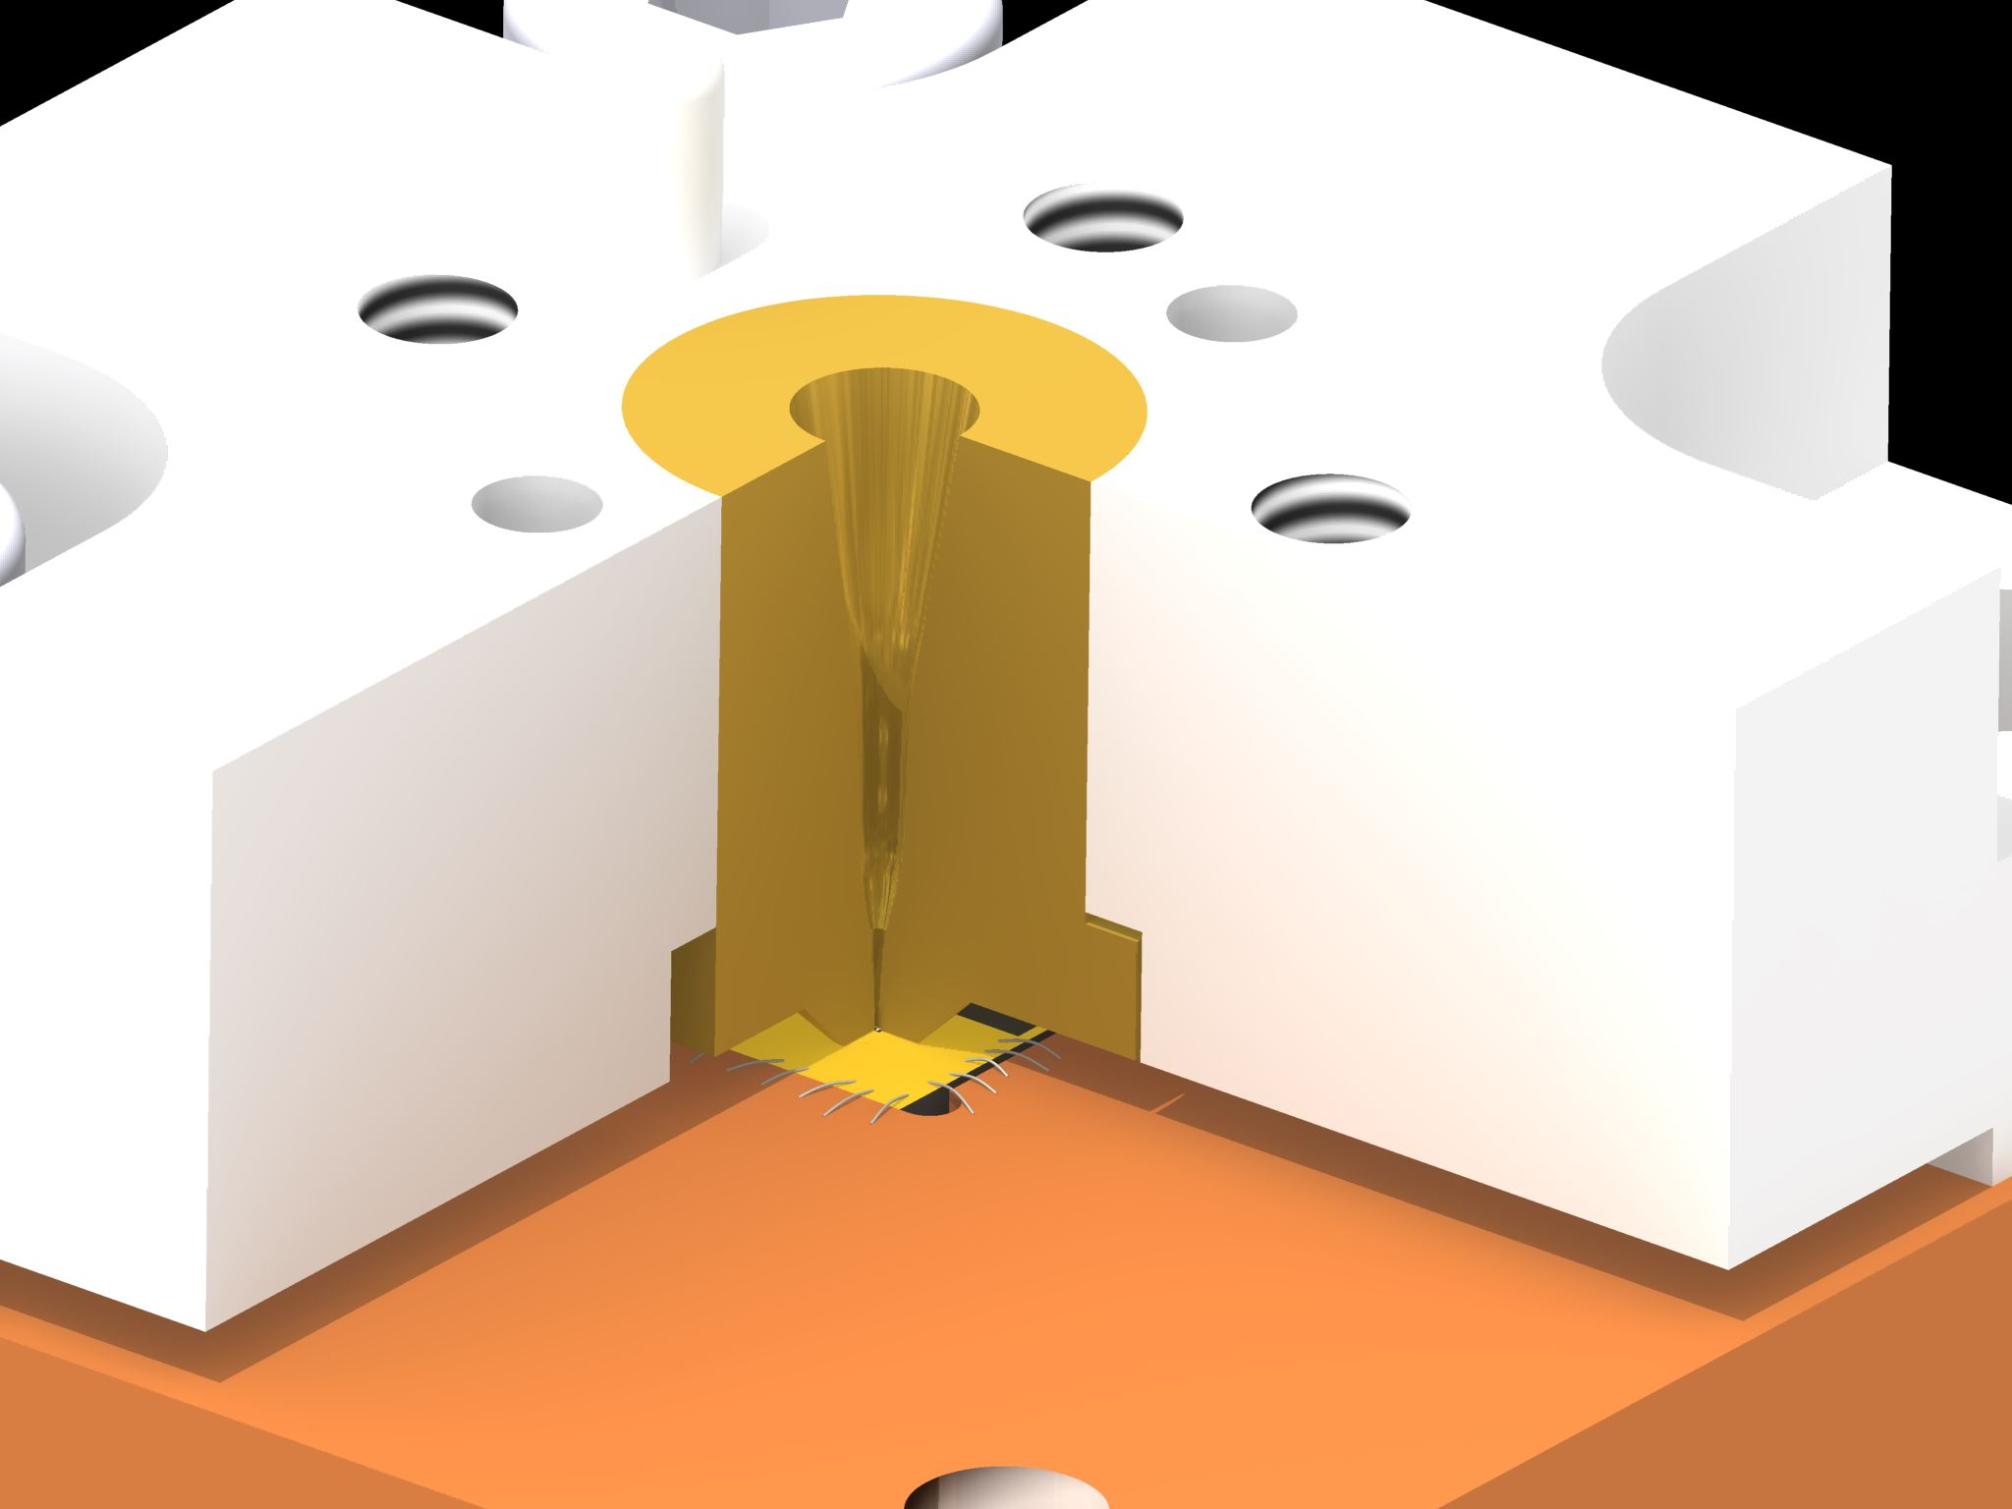
Feedhorn-mixer interface
xxx
4 mm

Slide 3
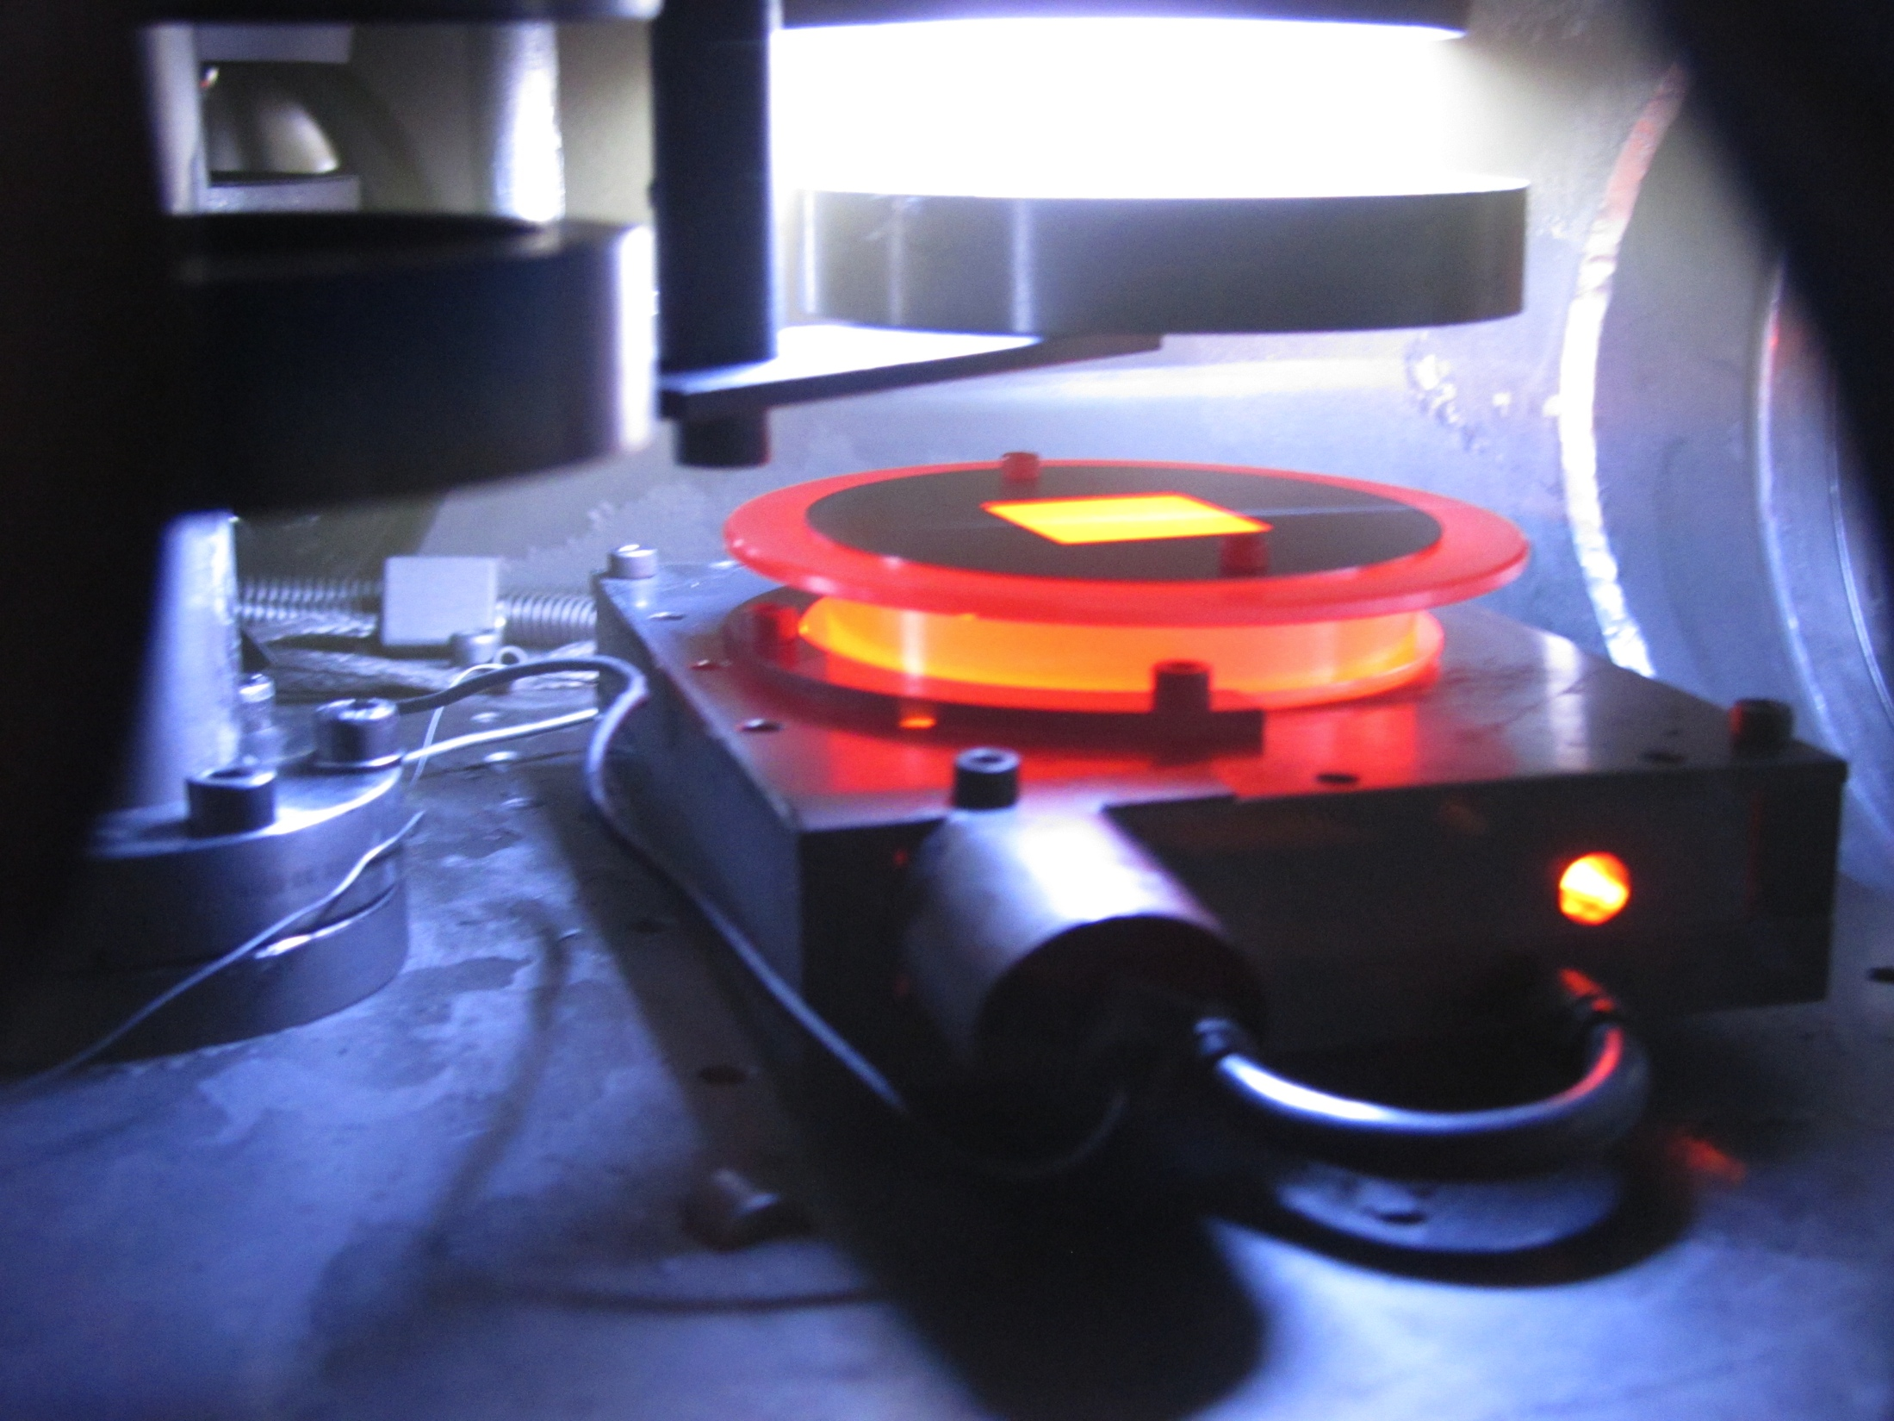
Fabrication of waveguide devices
NbN deposition @ 1000°C

Slide 4
Fabrication of waveguide devices
few nm thin superconducting microbridge layer is crucial for HEB performance characteristics
e.g. IF bandwidth, LO power consumption
NbN now replaces NbTiN as superconductor (higher IF)
2 µm thin membrane substrates
Si now replaces SiN (higher IF)
SOI wafer used for processing
DRIE definition for substrate shaping
fabrication split into frontside and backside processing
DC IV characterisation in-between
all fabrication incl. NbN layer in-house

Slide 5
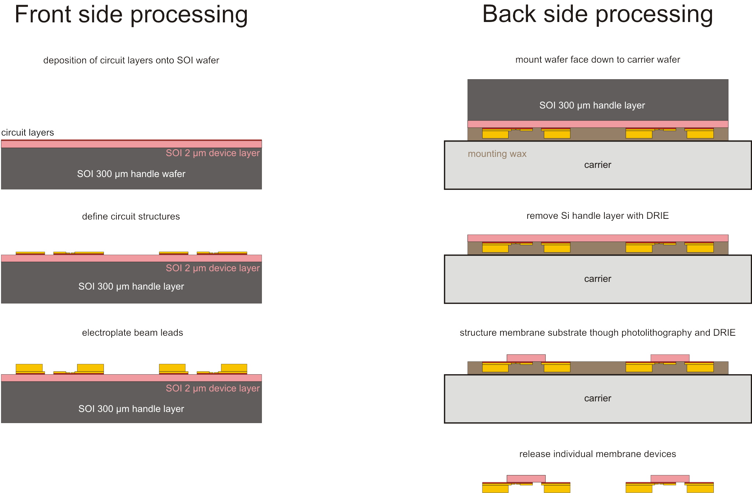

Slide 6
Device fabrication frontside

Slide 7
Device ready for IV tests

Slide 8
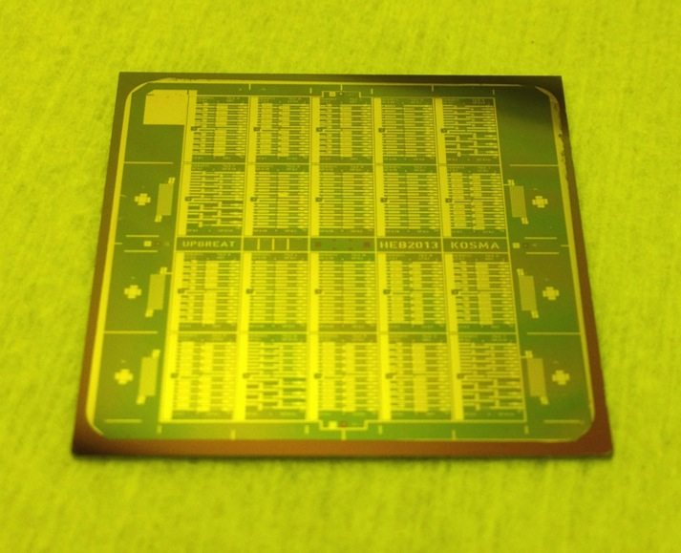
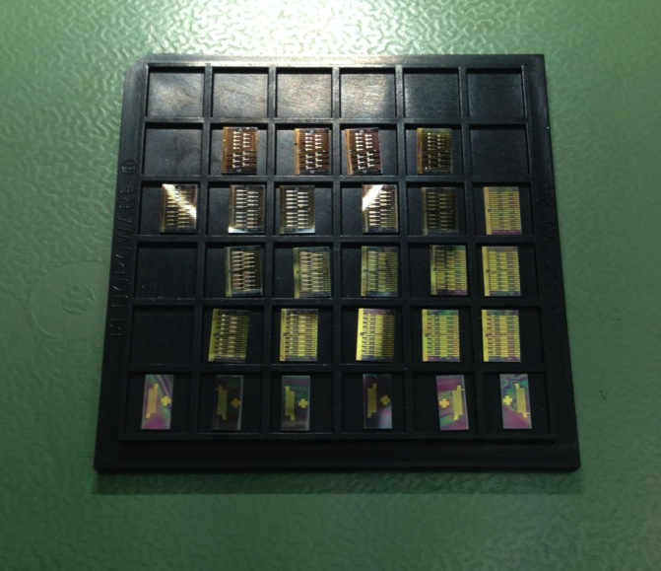
SOI wafer
348 HEB plus test devices
IV characterization before backside processing
backside processing on individual sections
30 mm
after frontside processing
diced for IV characterization

Slide 9
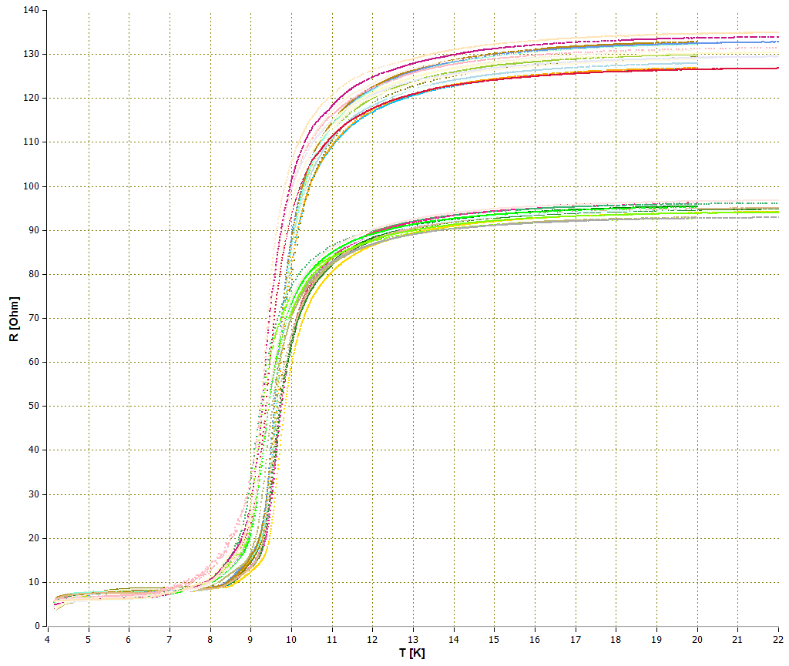
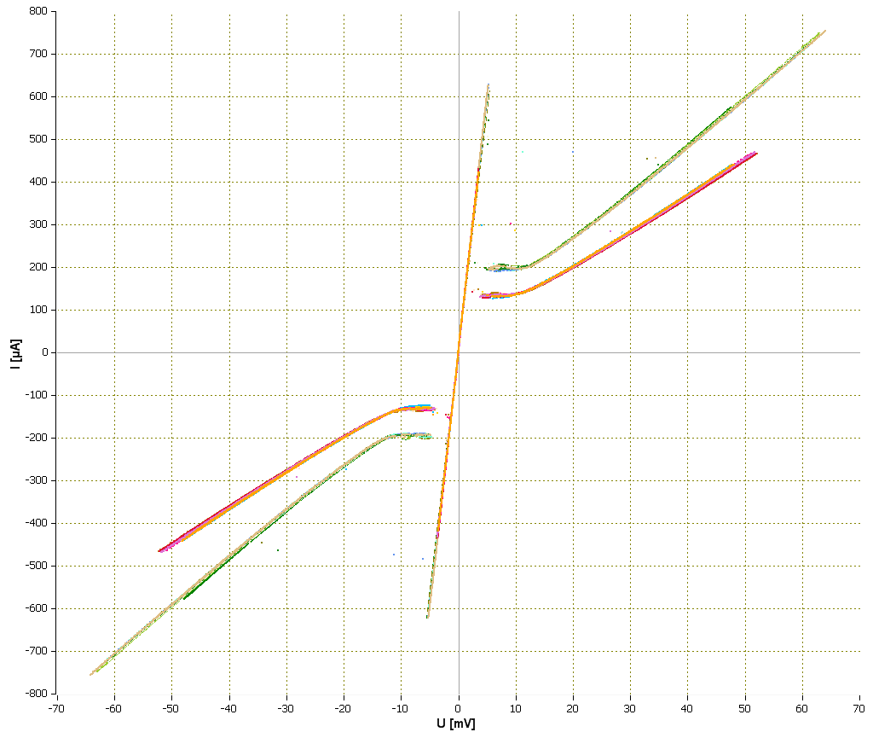
DC device characterization
device uniformity across wafer crucial for equal LO power consumption in array receiver
80 Ohm
RT
IV
120 Ohm
120 Ohm
80 Ohm
35 of 36 devices
after front side processes
18 devices after front side processing

Slide 10
Device fabrication backside

Slide 11
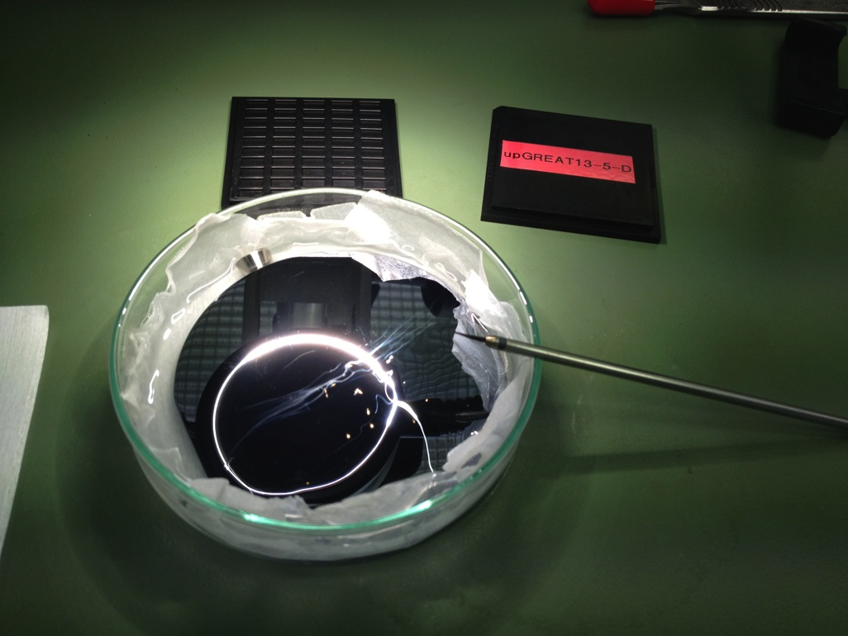
Fishing for devices …

Slide 12
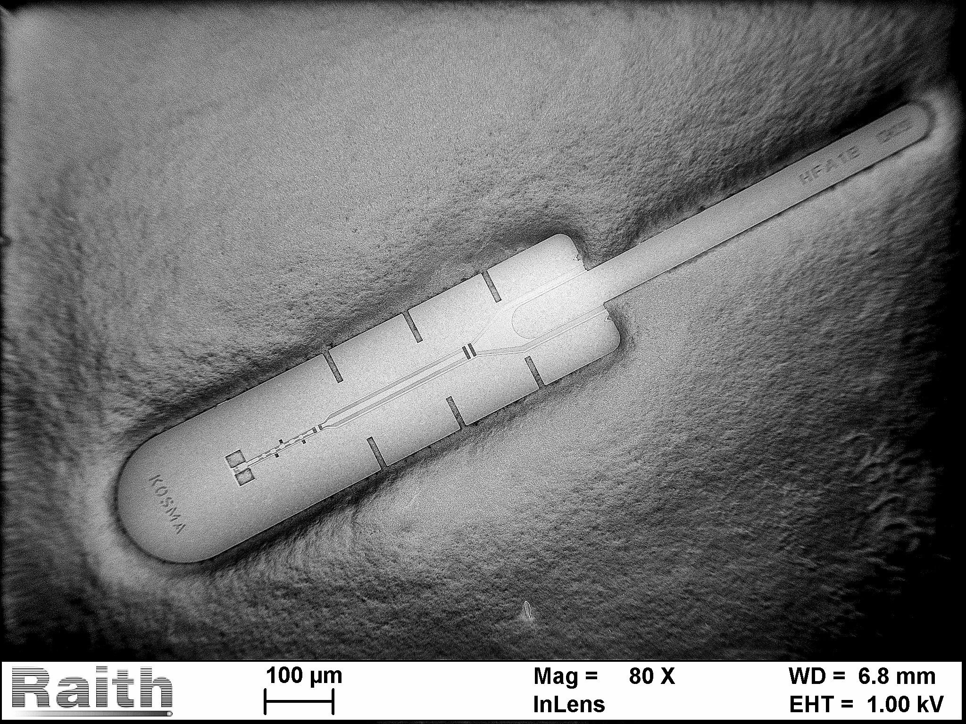
4.7 THz waveguide HEB device
IF output and DC connection
RF input section
1250 µm

Slide 13
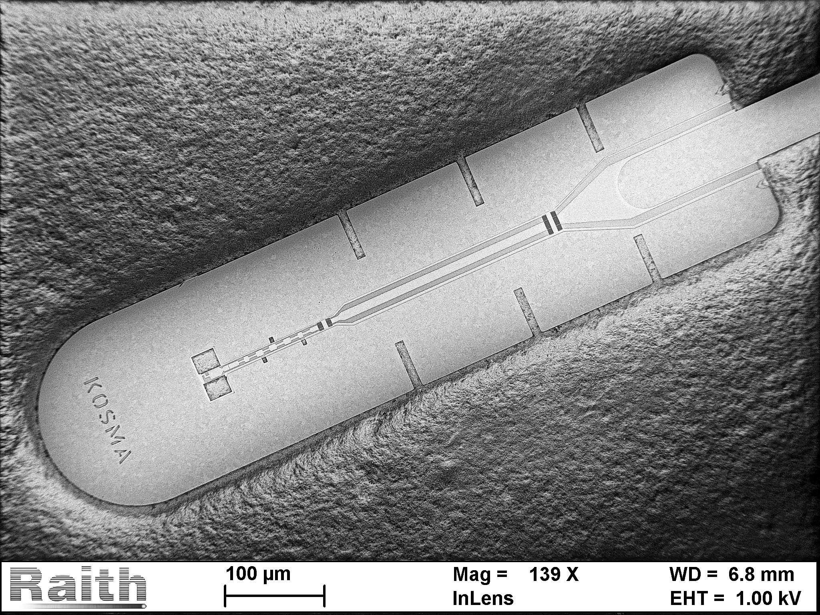
4.7 THz waveguide HEB device
beamlead
RF part with waveguide, probe antenna, transmission line chokes and HEB microbridge

Slide 14
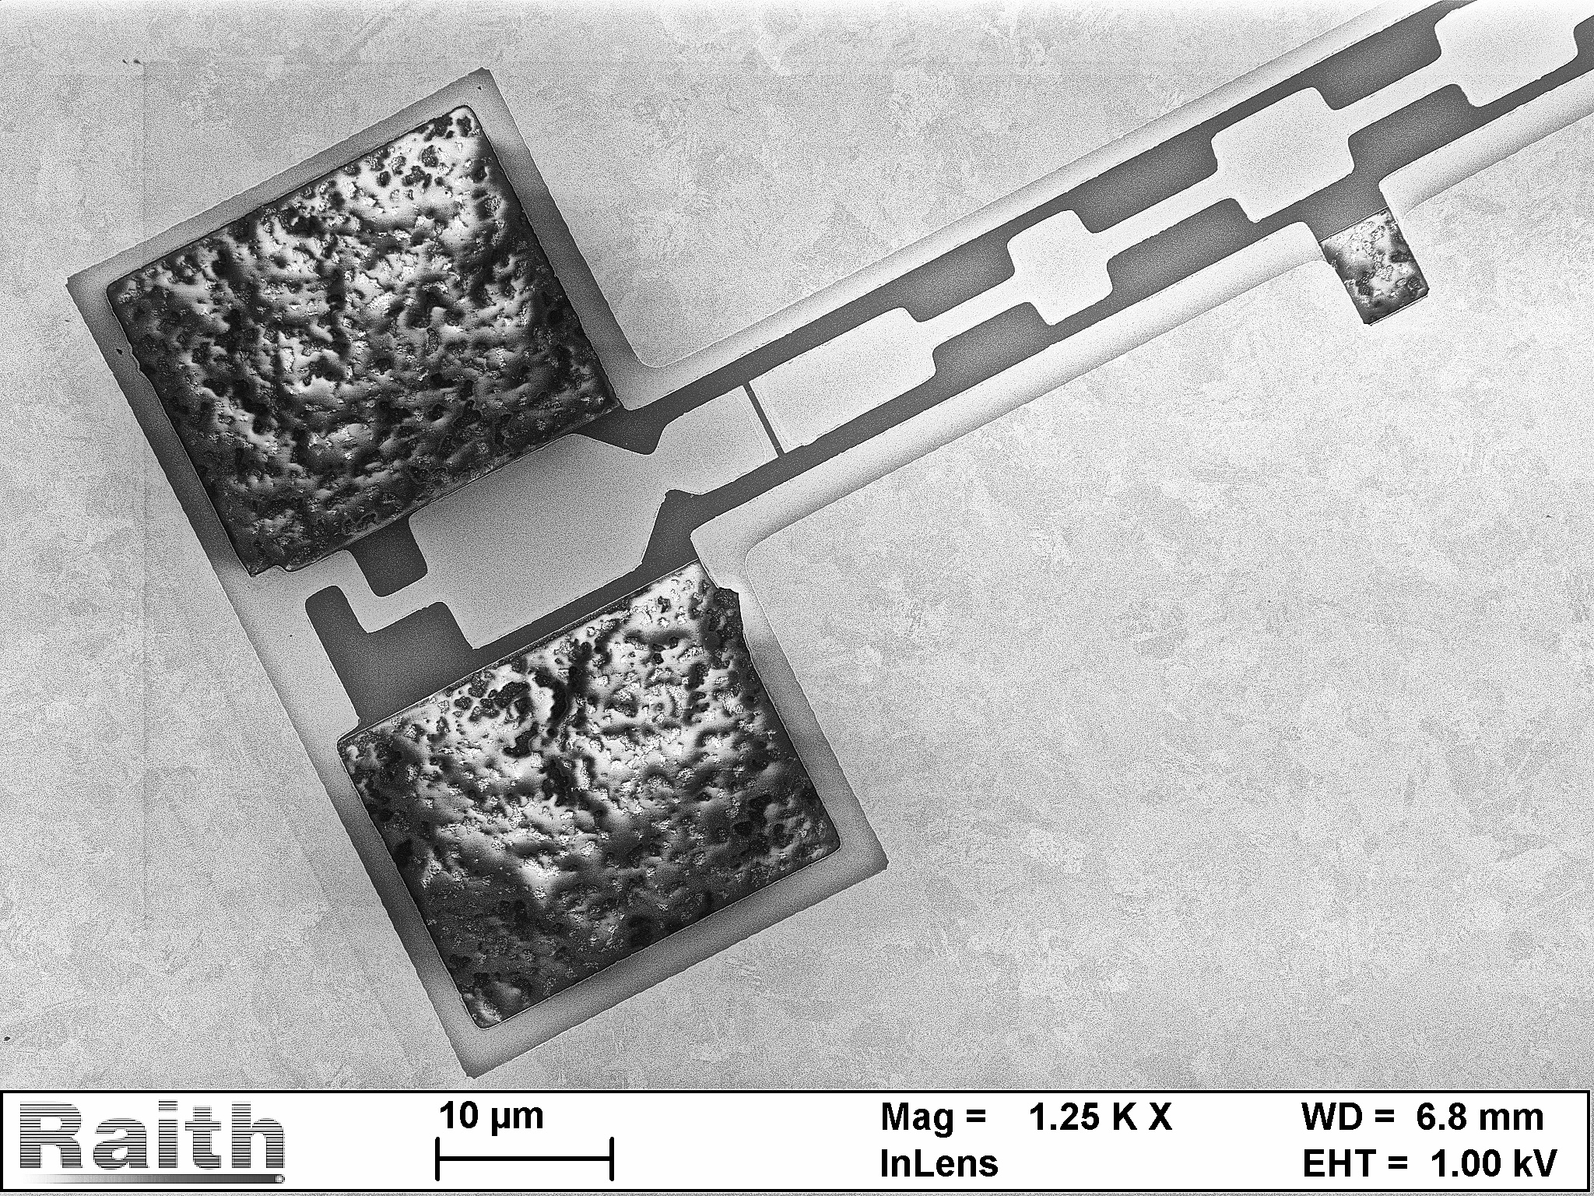
RF section of 4.7 THz HEB device
microstrip transmission line
with impedance matching
and choke sections
waveguide
window
alignment
window
waveguide
probe antenna
HEB
microbridge
λ/4 high Z
line to ground
3 µm electroplated
Au beamlead
2 µm Si
membrane
substrate

Slide 15
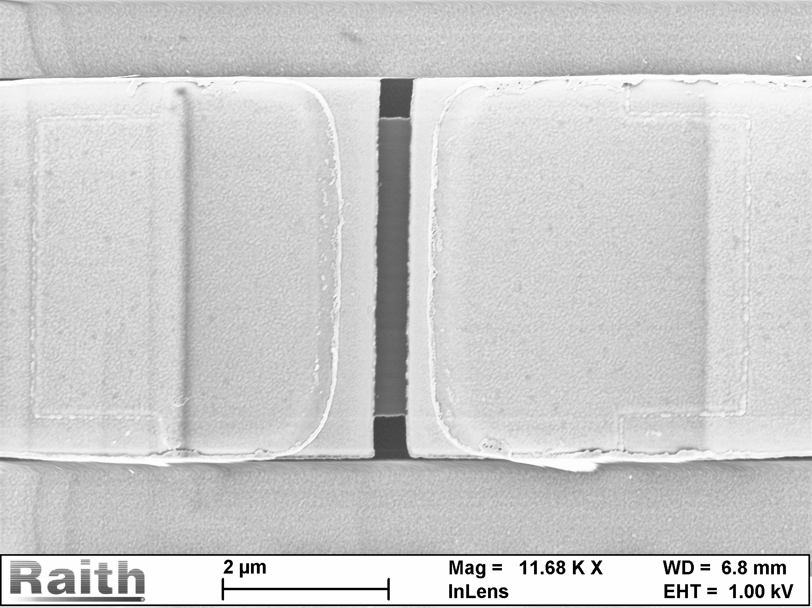
HEB microbridge with contacts
5 nm x 300 nm x 3600 nm x 5 nm NbN microbridge

Slide 16
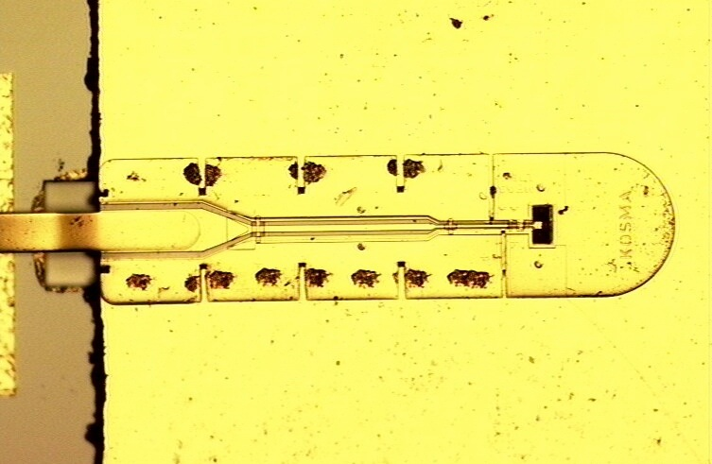
Device mounted and contacted
750 µm
HFA device

